Slide 1
Earth Day & Devils Club
By Mary Wilber & Arlie Neskahi
04/23/2021
6:30 PM Via ZOOM

Slide 2
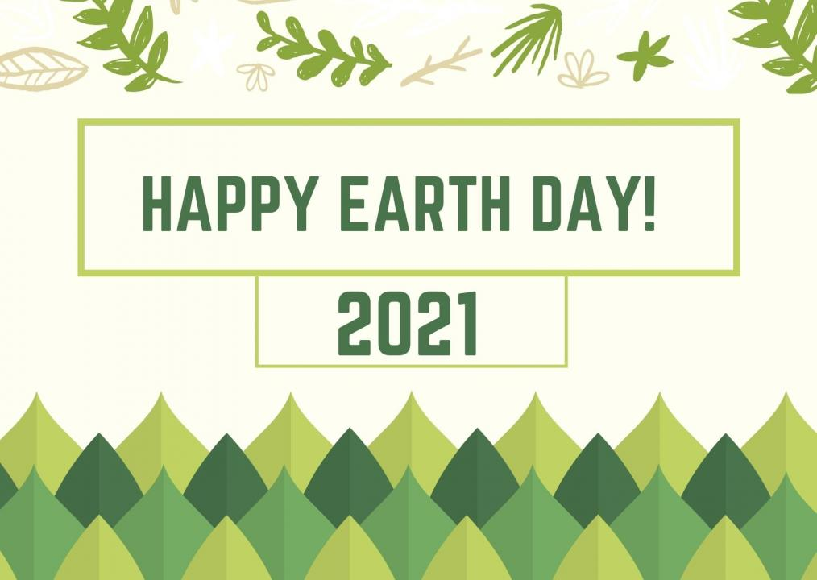

Slide 3
Earth Day is an annual event celebrated around the world on April 22 to demonstrate support for environmental protection.
First celebrated in 1970.
Earth Day now includes events coordinated globally by the Earth Day Network in more than 193 countries.
What did you do at school/home to celebrate Earth Day?
How do you say Mother Earth in your language?

Slide 4
Devil’s Club can teach us many things:
Every plant’s life is a journey Land stewardship Sustainable harvesting Listening to plants

Slide 5
Scientific Research
Devil’s Club
Oplopanax horridus
Ginseng Family (Araliaciae)
Oplo means “weapon” in Greek
Panax is from pan, meaning “everything”
Horridus means “bristly” or “wild”
Dena’ina: heshkeghka’a “big, big prickle”

Slide 6
Deciduous shrub Can be 5 – 10 ft. tall
Thorns or stiff, slender spines cover stems, leaf petioles, and veins on leaf surfaces.

Slide 7
Leaves usually start to emerge in late May, early June

Slide 8
At top of each stem is a crown of large leaves
Leaves are maple-shaped, with irregularly lobed margins. Each leaf is borne on long basally swollen petioles (stems)

Slide 9
The inflorescence is called a terminal umbelliferous raceme. Individual flowers are small, made up of a greenish white corolla of 5 petals. 5 stamens and 2 stigmas (usually). Late July.

Slide 10
Berries are somewhat flattened.
The Berries are red when ripe. Within the berries are usually 2 tan seeds.

Slide 11
Where is Devil’s Club found? Forest areas, shade and sun Mid to low elevations
Moist areas, stream banks

Slide 12
Traditional medicinal uses from literature:
Arthritis, Rheumatism, Diabetes Respiratory ailments, Coughs, Colds Sores, Swellings, Cuts, Boils Emetic, Laxative
Aid in child-birth, internal hemorrhaging Analgesic, treat stomach and digestive disorders Broken bones, fever, dandruff, lice, headaches Internal infections, treatment for cancer
Antimicrobial, Antimycobacterial, Antifungal, Antiviral
Cleansing, purification
Medicinal cannot be separated from spiritual.

Slide 13
Timing of harvest depends on who you talk to.
Some harvest year round
Some harvest only in the spring
Some harvest only in the fall
Harvesting during dormancy has a smaller impact on
regeneration the next year.
Some harvest early in the morning only on stems which
have the sun shining on them.
Some walk past first large clump of devil’s club before
harvesting the next.

Slide 14
Cultural Harvesting Practices
Don’t disturb the root. If there is lots of it, can thin it out. Secondary stalks for routine medicinal use
Don’t harvest the main stalk
Proper protocols: ask permission from plant; thank, and honor it afterwards.
Flowering and fruiting stems not harvested
Selective removal individual aerial stems and decumbent stems. (protect older and more vigorous stems)
Transplant sections of the stem in the mud.
Broken pieces often root naturally

Slide 16
Devil’s Club growing on banks of streams
provides shade for salmon and their eggs.
Grizzly and black bear eat seeds, leaves and stems. Elk and deer browse on it.
It provides hiding, escape, and thermal cover for birds and rodents.
For the plant community, Devil’s Club provides structure, nutrient cycling, soil stabilization.

Slide 17
Make friends with Devil’s Club, respect it, say please and thank you, understand how important it is for all of us, and you will be blessed by your relationship.

