Slide 1
ENAEP
Language Exploration
Colors
Arlie Neskahi and Mary Wilber
5/17/2021

Slide 2
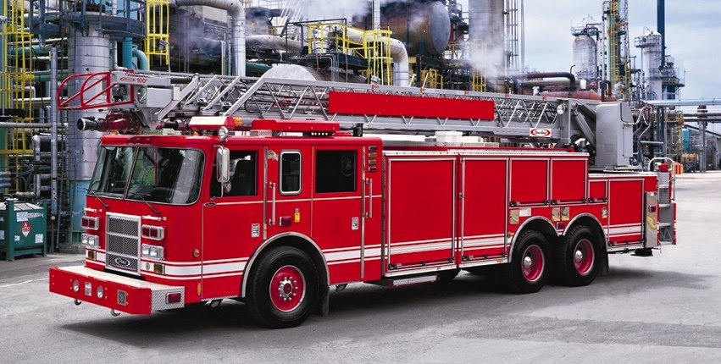
What color is the Fire Truck?

Slide 3
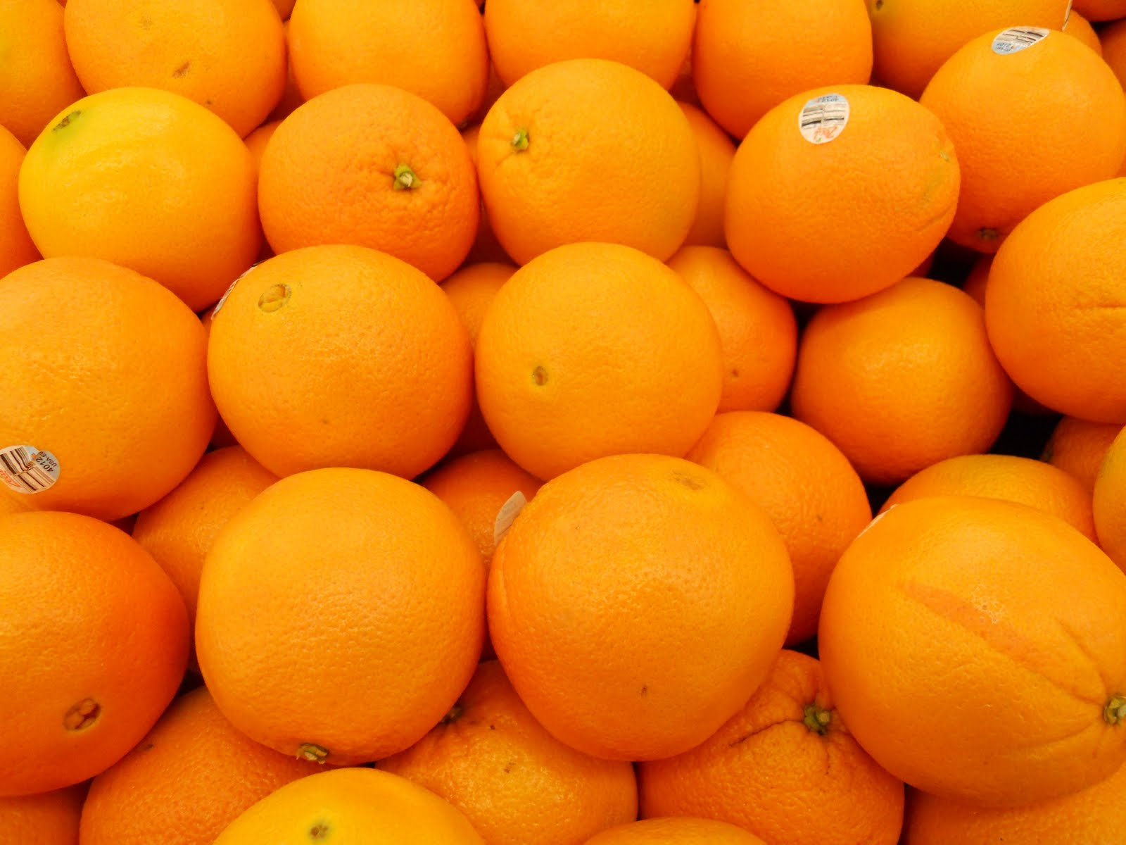
What color are the oranges?

Slide 4
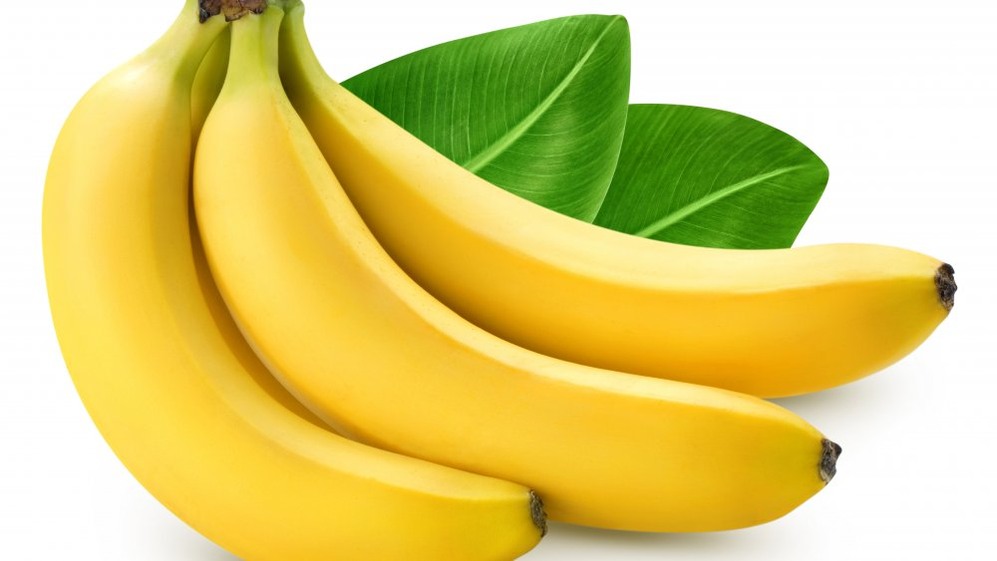
What color are the bananas?

Slide 5
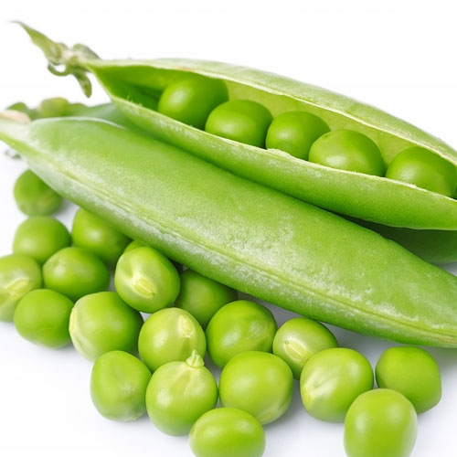
What color are the peas?

Slide 6
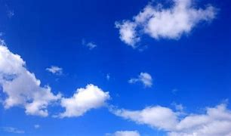
What color is the sky?

Slide 7
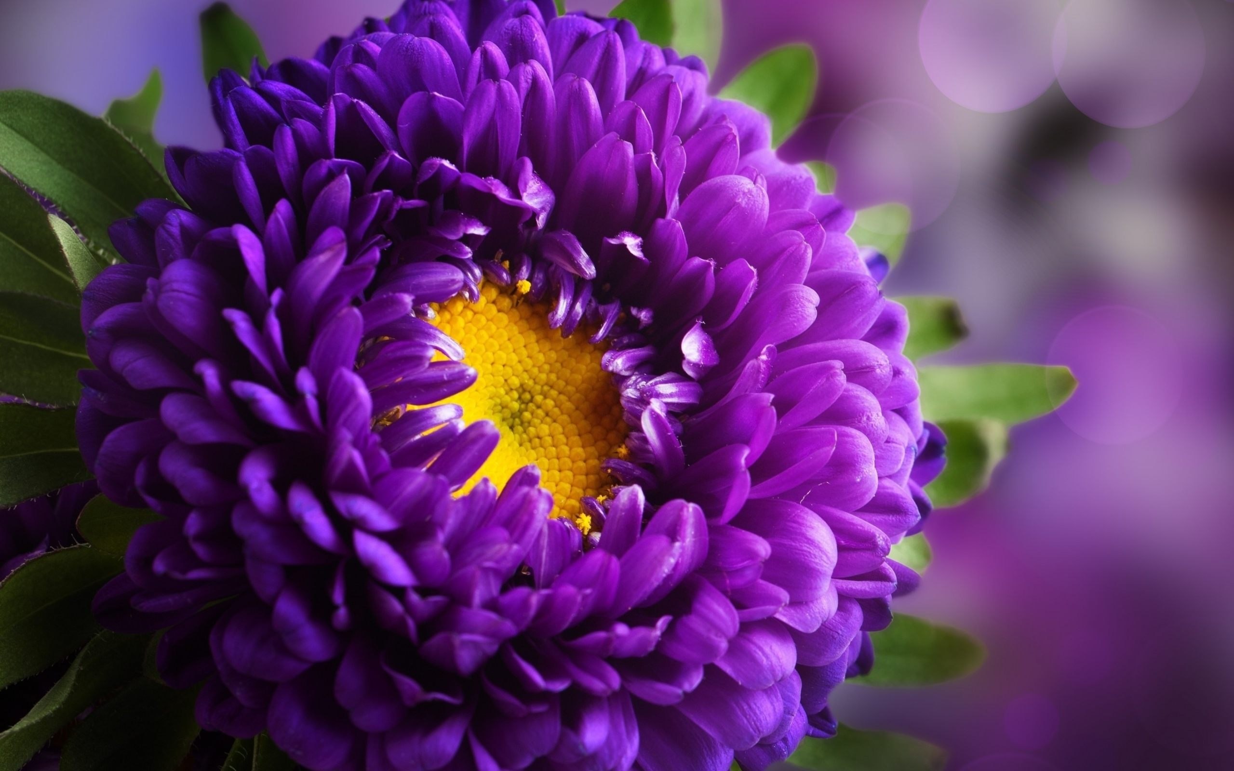
What color is the flower?

Slide 8
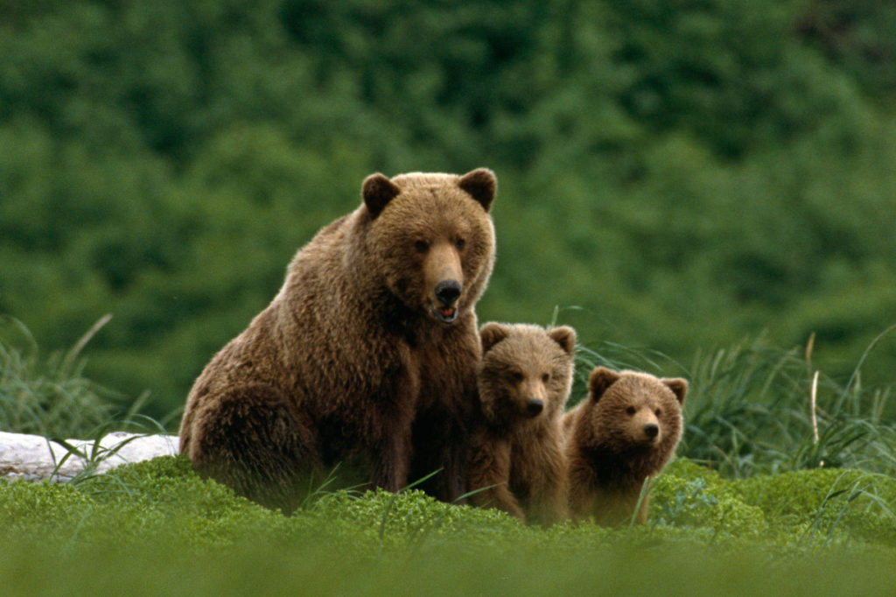
What color are the bears?

Slide 9
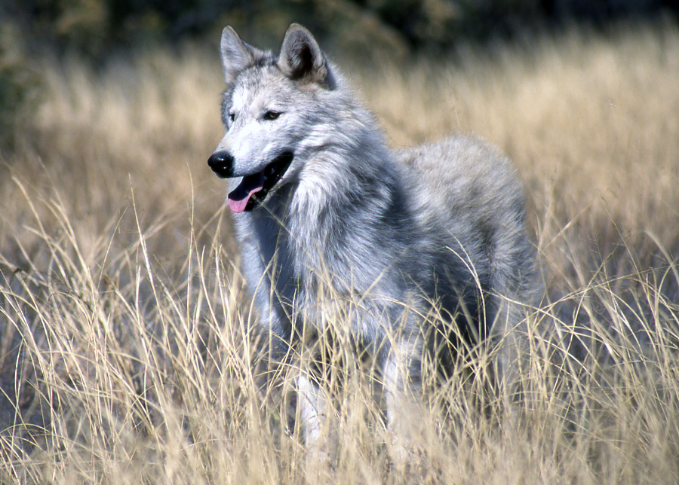
What color is the wolf?

Slide 10
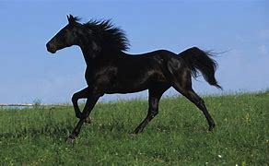
What color is the horse?

Slide 11
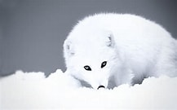
What color is the fox?

Slide 12
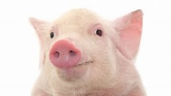
Extra Credit: What color is the pig?

