Slide 1

Earth Day 50 Years
How can we do our part to protect Mother Earth?
By Mary Wilber, Julie Hast
& Arlie Neskahi

Slide 2
Welcome: Julie Hast
Julie has been a environmental educator for over 30 years, leading children on nature walks, presenting assemblies to groups of 300+ students, creating curriculum & teacher workshops (that’s where she met Arlie!) and even helping with commercials and videos about Recycling.
She is currently a consultant for the City of Los Angeles and has helped with programs at Disneyland, Universal Studios, Los Angeles Airport, Toyota & Honda Headquarters and will be helping to develop a educational center for a project for the Native American Tribe, Gabrieleno Tongva (GTT)

Slide 3
History of Mother(Tuma)(Shima) Earth Day
Show Video Clip

Slide 4
WEB OF LIFE “Sharing Nature with Children” by Joseph Cornell.

Slide 5
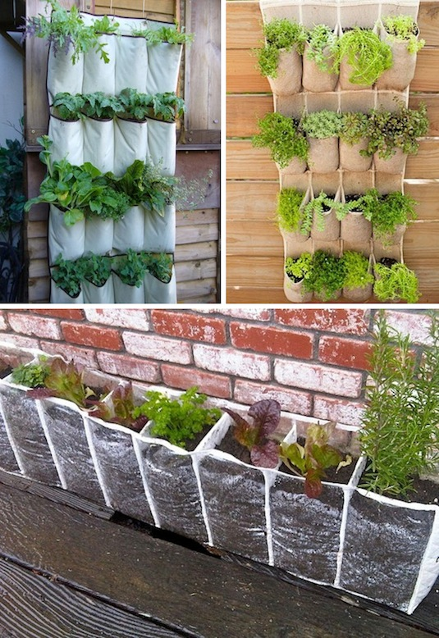
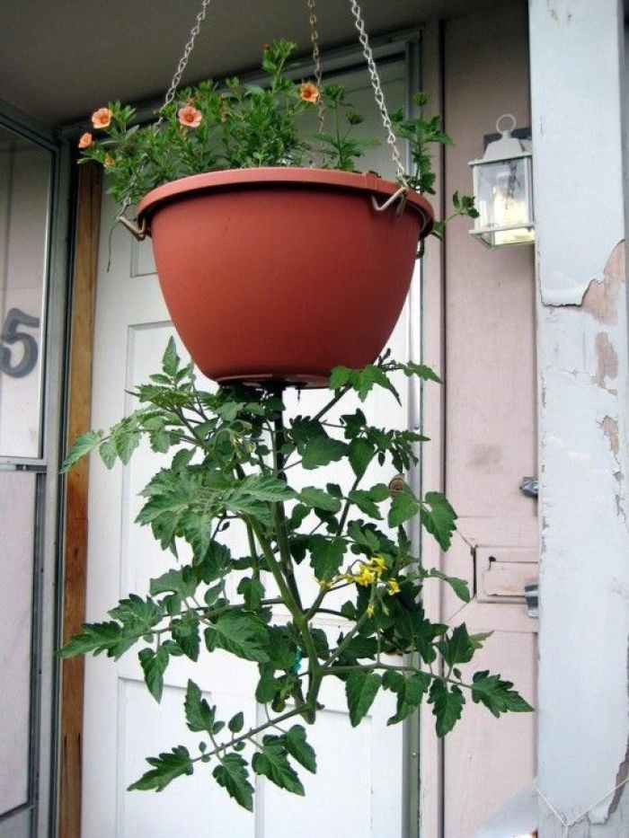
(1) Plant Something
Earth Day is the perfect time to embark on a large family project like a garden.
If you don't have the space, start small. Planting just about anything -- even a tiny windowsill plant
Plant a tree(cedar tree)
Plant a flower

Slide 6
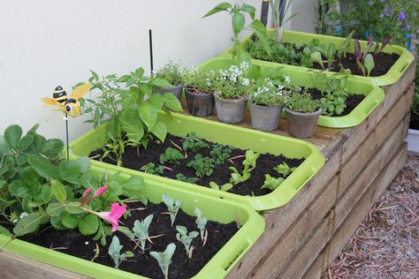
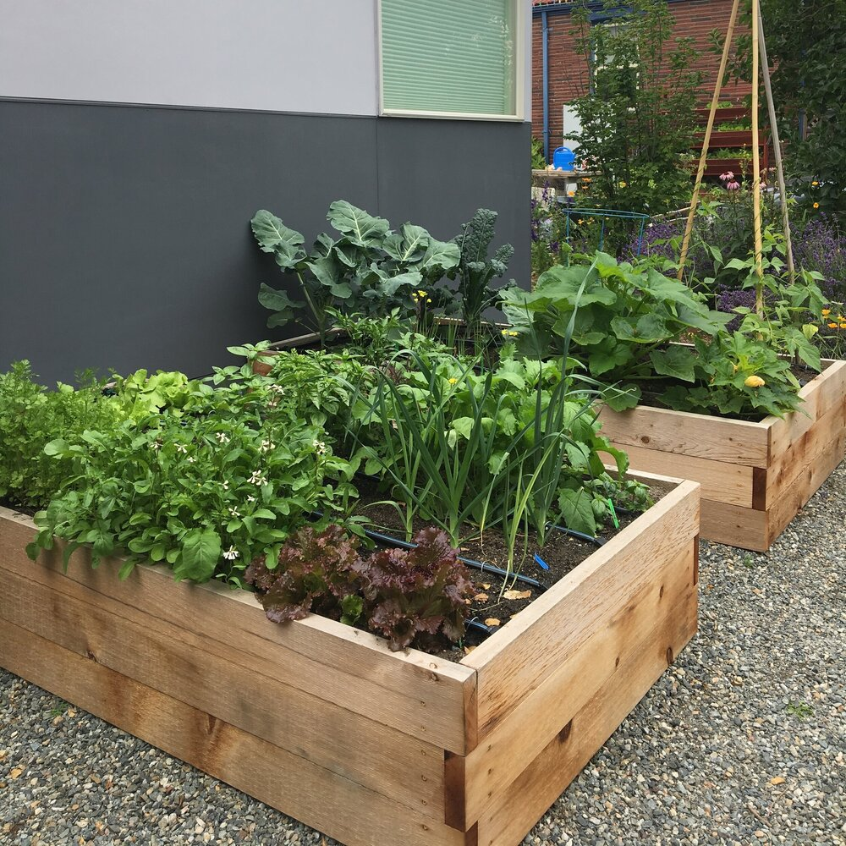

Slide 7
(2) HELP THE ANIMALS
Volunteer at your favorite animal shelter.
Take your horse on a trail ride through the forest.
Take your dog to the beach or to his favorite park.
Find a special patch of sun for your cat.
Plant a butterfly garden
Buy your animal a sustainable toy
Create animal friendly areas in your backyard
Adopt a wild animal online
Eat greener and strive for a Meat-free Monday

Slide 8

(3) DRIVE LESS
Bike to work/school. The majority of Americans live close to their workplace.
Walk more. Get a kickstart to your day by walking to work/school.
Organize a carpool. Find a friend who lives and works close to you,...
Or let someone arrange a pool for you. Try UberPOOL or Lyft Line,...
Invest in a hybrid car

Slide 9

(4) MAKE LESS TRASH
Bring your own cutlery, cups, napkins and grocery bags wherever you can. “ use clothe linens, have a fork in the car, use reusable bags for produce.
Learn what grade of plastic your city or county recycles. Here’s a guide to what the numbers mean.
Biodegradable does not mean compostable.
You might be able to recycle or compost unexpected things: You can compost a pizza box, and you can recycle foil, if you scrape the goop off.

Slide 10

Create a Personal or Family Project
Plant Something
Help The Animals
Drive Less
Make Less Trash
Other

