Slide 1
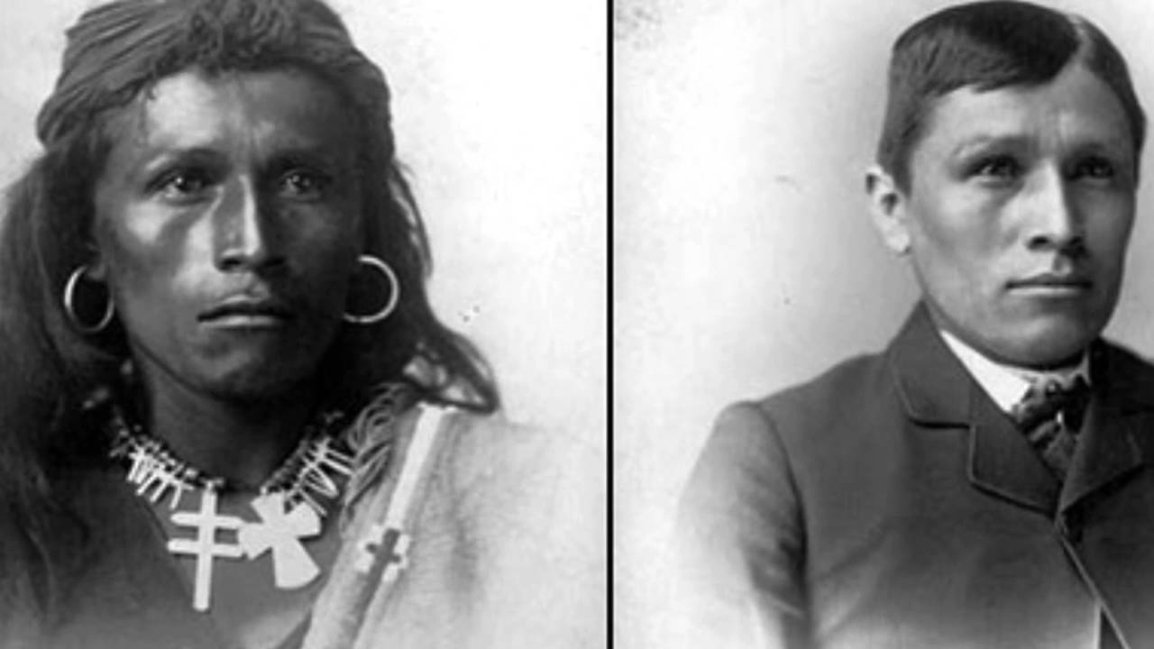
Kill the Indian, Save the Man
Captain Richard Pratt, Founded Carlisle Indian Boarding School 1879

Slide 2
Remains of 215 children found at closed Canada boarding school for Indigenous People

Slide 3
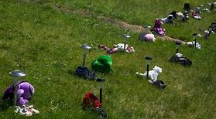
182 unmarked graves found near former residential school outside Cranbrook, B.C.

Slide 4
Remains of 215 children found at closed Canada boarding school for Indigenous People

Slide 5
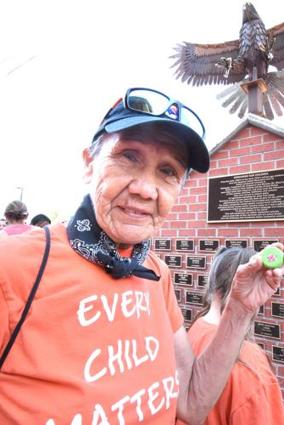
1,000 march in support of residential school survivors
“I don’t really want to speak, but I must because of the debt owed to the children here,” said Kamloops residential school survivor Roger Hall, looking towards the wall.
“If we don’t speak that means we didn’t really survive, we just existed.
‘I must speak because some of us were beaten, some of us were raped and some of us died.”

Slide 6
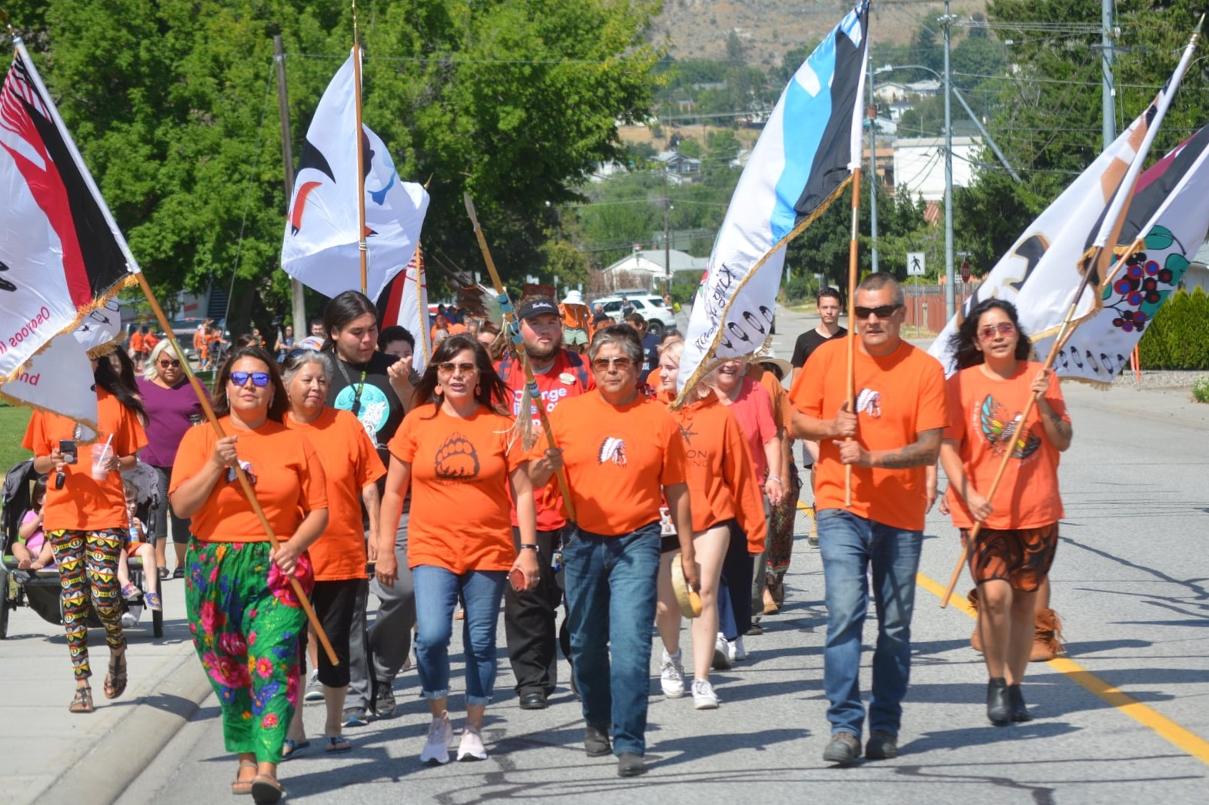
Orange Shirt
The first Orange Shirt Day was celebrated on September 30, 2013, in honor of Native American and Indigenous boarding school survivors, descendants and deceased students. These boarding schools were created by the federal government and religious missionaries to assimilate Native American and Indigenous children into Western culture and to eradicate the practice of their traditional culture, language and ceremony. The day is known as “Orange Shirt Day” after former student Phyllis Webstad shared her story of her first day at boarding school in which her favorite orange shirt was taken away. September 30 has been annually declared Orange Shirt Day in recognition of the harm that the Native American and Indigenous boarding school system did to generations of Native American and Indigenous families and communities
WELCOME (orangeshirtday.org)

Slide 7
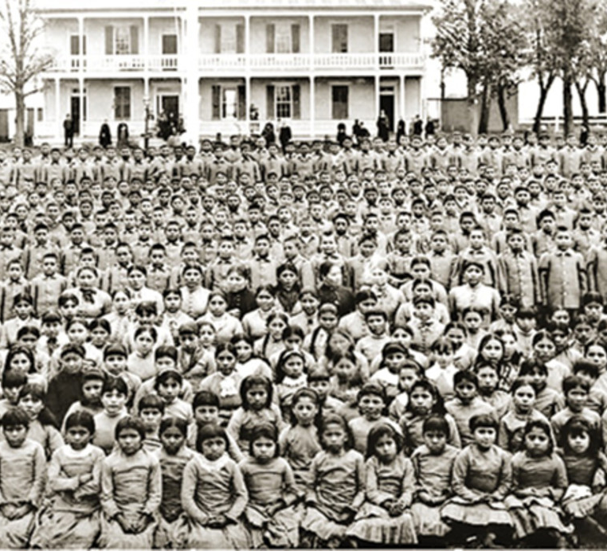
How To Raise Awareness:
For more than a century, children were systematically removed from their homes and sent to residential schools(140 Residential Schools, Canada) (more than 350 Indian Boarding Schools, United States)
Where they were forbidden to speak their language or practice their culture.
Why do we need to learn about residential schools?
How do you talk about cultural genocide today? How do we heal together? Where do we start?
What can you do to raise awareness?

