Slide 1
Native American Women
In the Modern Day

Slide 2
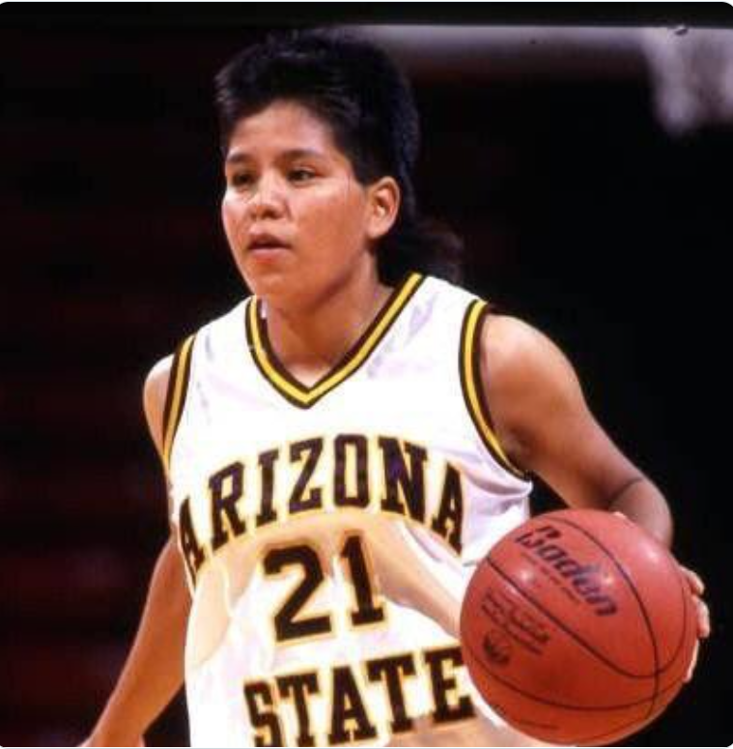
Basketball
Ryneldi Becenti
A member of the Dine tribe
Went to ASU and was All Pac-10 and All-American
Became the first Native American in the WNBA and played on the Phoenix Mercury
She grew up playing basketball with her brothers and dreamed of being a state champion.

Slide 3
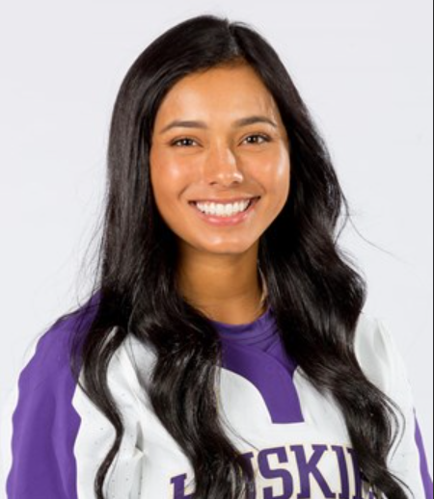
Softball
Silentrain Espinoza played softball
For the University of Washington
Penobscot and Kumeyaay Tribes
Values perseverance and her culture
And said it is what got her where she is
Sociology Major class of 2022

Slide 4
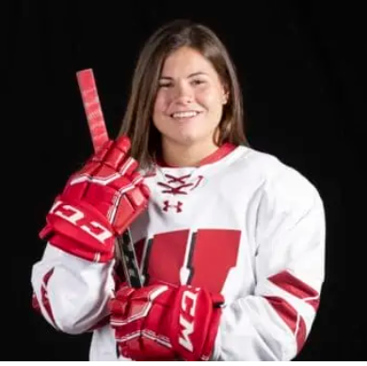
Hockey
Abby Roque
Ojibway from the Wahnapitae First Nation.
Grew up playing in Michigan
University of Wisconsin
Helped to win Silver medal in 2022 Olympics

Slide 5
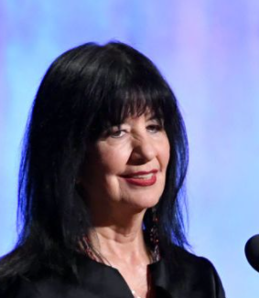
Poet
Joy Harjo-Frist Native American Poet Laureate
Muscogee Tribe

Slide 6
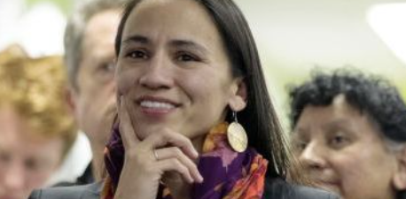
Politics
Sharice Davids, Ho Chunk
Deb Halaand, Laguna Pueblo
First two Native American women elected to congress

Slide 7
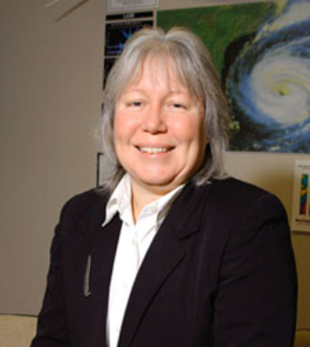
Science
Robbie Hood
first permanent director of NOAA's Unmanned Aircraft Systems Program
Cherokee
Works for NASA

