Slide 1
Powerful Native Women
Taking the rules back

Slide 2
Strong Bonds to Society
Medicine
Susan La Flesche
Omaha
Education
Zitkala-Sa, Red Bird
Gertrude Simmons, married name Gertrude Bonnin, Yankton Sioux Agency
Civil Rights
Elizabeth Wanamaker Peratrovich
Tlingit

Slide 3
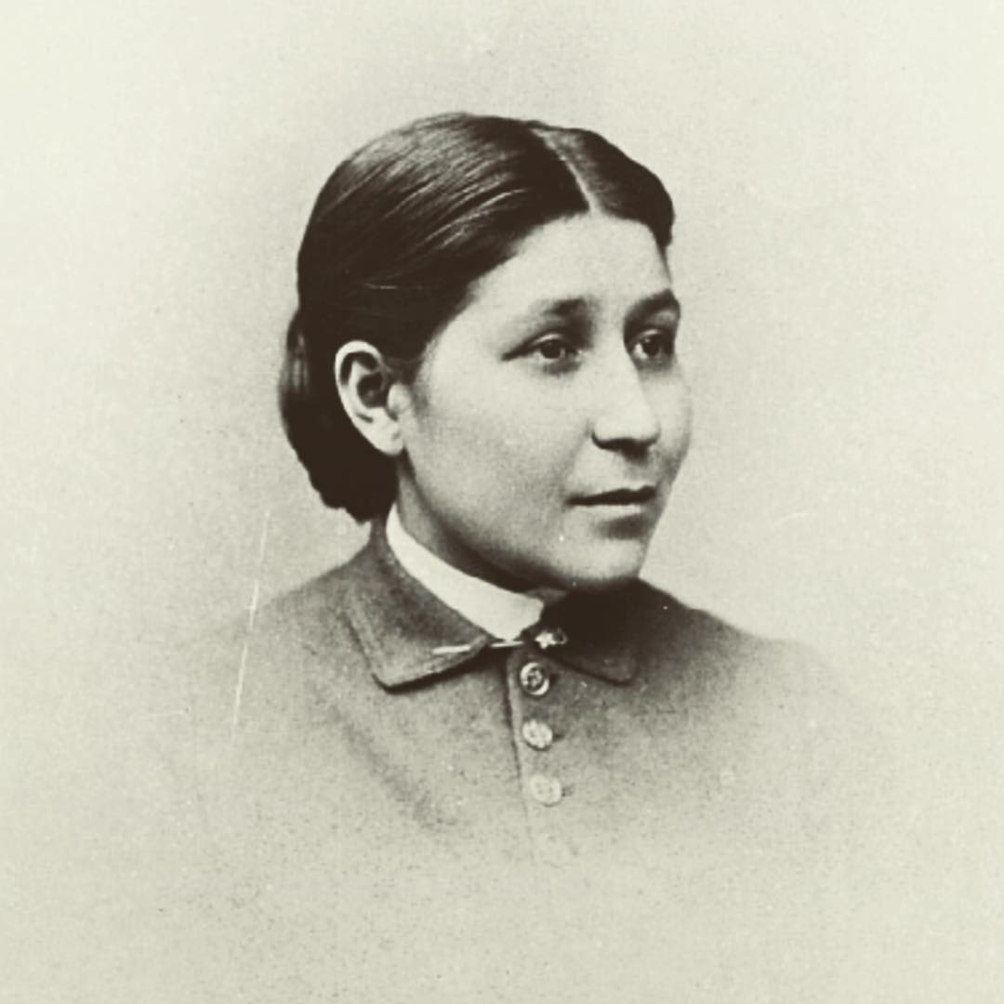
Susan La Flesche Omaha Doctor of Medicine
Susan LaFlesche Picotte was born June 17, 1865 and lived as an Omaha Native and reformer until September 18, 1915
Most acclaim her as the first Native American to earn a medical degree.
She campaigned for public health and for the formal, legal allotment of land to members of the Omaha tribe. She worked to discourage drinking on the reservation, as part of the temperance movement of the 19th century, and where she served as physician.
Picotte also ran other public health campaigns to prevent and treat tuberculosis on the reservation.
She also worked to help other Omaha navigate the bureaucracy of the Office of Indian Affairs and receive the money owed to them for the sale of their land.

Slide 4
Zitkala-Sa, Red Bird Sioux Native Author
Born Gertrude Simmons to a Yankton Sioux mother and a Euro-American father in 1876, then taking the name Zitkala-Sa, Red Bird, in her teens. She accomplished many things in her journey before she died in January 1938.
Traditional education commenced for her at age 8. She went to a Quaker missionary school in Indiana, White’s Manual Labor Institute. She continued to a Quaker college, Earlham College, also in Indiana but against her family’s wishes, and graduated in 1897.
She then taught at the Carlisle Indian Industrial School for 2 years but left due to disagreement with the harsh discipline style and curriculum of stripping heritage and cultural identities
First Native American to compose an opera, The Sundance, premiering Utah and later staged periodically by rural troupes before being performed in 1938 by the New York Light Opera Guild.
Expanded Native opportunity while maintaining cultural heritage and integrity
In 1901, she published Old Indian Legends, regarding themes derived from her struggle to retain her cultural identity amid pressure to adapt to the dominant American culture.
She became the secretary of the Society of the American Indian in 1917, moving she and her husband to Washington DC, where she would be a liaison between the society and the Bureau of Indian Affairs.
As editor of American Indian Magazine (1918–19), under the name Gertrude Bonnin, she coauthored (with Charles H. Fabens and Matthew K. Sniffen) the book Oklahoma’s Poor Rich Indians, an Orgy of Graft and Exploitation of the Five Civilized Tribes, Legalized Robbery (1924), an expose of the mistreatment of Natives in Oklahoma.
After founding the National Council of American Indians in 1926, and, serving as the organization’s president, she advocated citizenship rights, better educational opportunities, improved health care, and cultural recognition and preservation. Her investigation of land swindles perpetrated against Native Americans resulted in her appointment as an adviser to the U.S. government’s Meriam Commission of 1928, the findings of which eventually led to several important reforms. She remained active as a spokesperson for Native American concerns until her death.

Slide 5
Elizabeth Wanamaker Peratrovich
Elizabeth Wanamaker Peratrovich was born in 1911 and spent her childhood in Alaska. Peratrovich then moved to Bellingham, Washington to attend college. When she returned to Alaska, 10 years later, Peratrovich was shocked by the blatant discrimination towards Native Alaskans
She and her husband, also born Tlingit, moved from their small town of Klawock to the state capital of Juneau. But according to Indian Country Today, they found Native people were not welcome in city buildings, areas of town and there were restrictions on real estate. “No Natives Allowed” signs were openly posted almost everywhere they went and were kept out of many public spaces, including some hotels, restaurants, and movie theaters.
Peratrovich petitioned Alaska Governor Ernest Gruening to introduce the Anti-Discrimination Act of 1945. The first of its kind in an American territory or state, the groundbreaking law prohibited discrimination in public accommodations and facilities. Peratrovich also played a critical role in the law’s passage, providing powerful testimony before the State Senate at a hearing to determine the legislation’s fate: “Who are these people, barely out of savagery, who want to associate with us whites, with 5,000 years of recorded civilization behind us?,” Senator Allan Shattuck, who opposed the law’s passage, asked early on in the hearing.
Peratrovich’s response? “I would not have expected that I, who am barely out of savagery, would have to remind a gentlemen with 5,000 years of recorded civilization behind them, of our Bill of Rights.”
The bill passed 11 to 5 on February 8, 1945. Today, Alaska celebrates Peratrovich’s (aka “fighter in velvet gloves”) contribution to Native equality every February 16th, “Elizabeth Peratrovich Day.” in 2020, the U.S. Mint honored her civil rights legacy by putting her face on a commemorative one dollar coin.

