Slide 1
Womens History Month
ENAEP Program
March 15, 2021

Slide 3
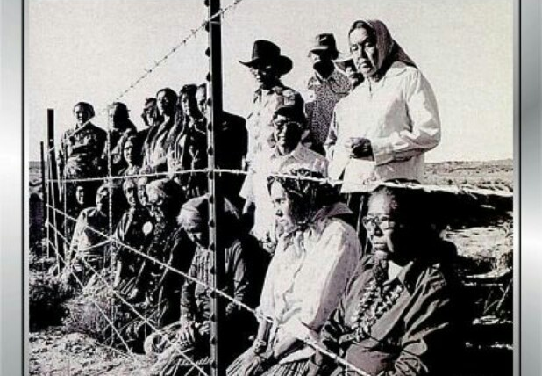

Slide 4
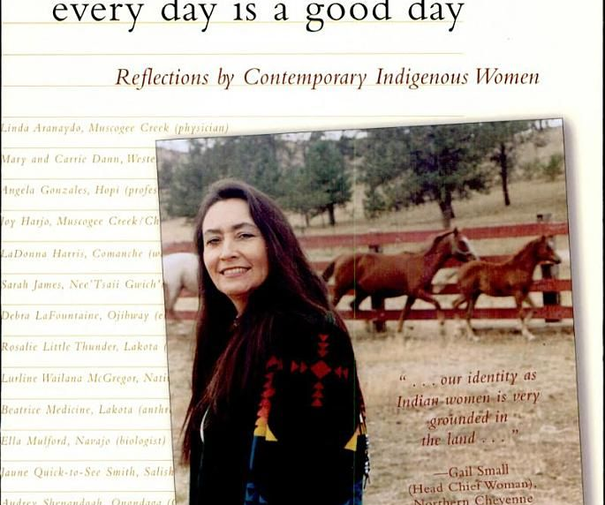

Slide 5
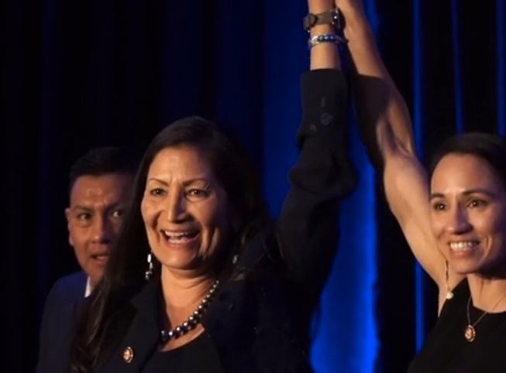
Senator Deb Haaland , Laguna Pueblo

Slide 6
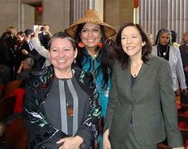
Deborah Parker, also known by her native name Tsi-Cy-Altsa, is an activist and indigenous leader in the United States. A member of the Tulalip Tribes of Washington, she served as its vice-chairwoman from 2012 to 2015 and is, as of July 2018, a board member for Our Revolution and the National Indigenous Women's Resource Center. She is also a co-founder of Indigenous Women Rise. During the Violence Against Women Reauthorization Act of 2013.

Slide 7
Claudia Kauffman was the first woman Native American elected to the Washington State Senate. She was raised in the Beacon Hill neighborhood of Seattle where her mother, Josephine, championed American Indian rights in the area. Kauffman, who is of the Nez Perce Tribe, spent her legislative career (2006-2010) serving the 47th district, taking a particular interest in issues of early childhood learning and education. Kauffman also founded the Native Action Network, a non-profit that supports female Native Americans. She lives in Kent with her husband and children.

Slide 8
Executive Director of Chief Seattle Club, enrolled member of the Pawnee Nation and member of the Upper Athabascan people
Colleen Echohawk for Seattle Mayor
We have the power to choose our future.
It’s time for people-first leadership!

Slide 9
Fawn Sharp, NCAI President
Fawn R. Sharp serves as the 23rd President of the National Congress of American Indians (NCAI), the oldest, largest and most representative American Indian and Alaska Native tribal government organization in the country. President Sharp was elected on October 24, 2019 at NCAI’s 76th Annual Convention & Marketplace. Sharp is the third woman to hold the position of NCAI President.
President Sharp is the current President of the Quinault Indian Nation in Taholah, Washington. Her past positions included managing attorney and lead counsel; and staff attorney for the Quinault Indian Nation, administrative law judge for the Washington state Department of Revenue – Tax Appeals Division, Quinault Tribal Court Associate Judge, and Counsel for Phillips, Krause & Brown.

Slide 10
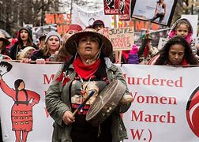
Roxanne White sees what could have been her fate in the faces of Missing and Murdered Indigenous Women. An enrolled citizen of the Nez Perce Tribe who was born and raised on the Yakama Nation Reservation, she is one of the most prominent activist voices in Seattle. She harnesses the power of her story to fight for families and victims, and raise awareness of the disproportionate danger that Native women face.
.

